Slide 1


Lecture 5 Solidity and Remix 2
Hyoung Joong Kim
Kookmin University
March 30, 2026

Slide 2
// Function to allow users to withdraw ETH
function withdraw() external {
// Check if the user has waited long enough since their last withdrawal
require(
block.timestamp >= lastWithdrawalTime[msg.sender] + LOCK_TIME,
"You must wait 24 hours between withdrawals."
);
// Check if the contract has enough balance
require(
address(this).balance >= WITHDRAWAL_AMOUNT,
"Insufficient balance in the faucet."
);
// Update the last withdrawal time for the user
lastWithdrawalTime[msg.sender] = block.timestamp;
// Send ETH to the user
payable(msg.sender).transfer(WITHDRAWAL_AMOUNT);
// Emit the withdrawal event
emit Withdrawal(msg.sender, WITHDRAWAL_AMOUNT);
}
// Function to allow the owner to deposit ETH into the faucet
function deposit() external payable onlyOwner {
// No additional logic needed; ETH is sent with the transaction
}
// Function to allow the owner to withdraw all ETH from the faucet
function withdrawAll() external onlyOwner {
// Transfer the entire balance to the owner
owner.transfer(address(this).balance);
}
// Fallback function to accept ETH sent directly to the contract
receive() external payable {}
}
Faucet
// SPDX-License-Identifier: MIT
pragma solidity ^0.8.0;
contract Faucet {
// Address of the contract owner
address payable public owner;
// Amount of ETH to send per request
uint256 public constant WITHDRAWAL_AMOUNT = 0.1 ether;
// Time lock to prevent frequent withdrawals
uint256 public constant LOCK_TIME = 1 days;
// Mapping to track the last withdrawal time for each address
mapping(address => uint256) public lastWithdrawalTime;
// Event to log withdrawals
event Withdrawal(address indexed user, uint256 amount);
// Modifier to restrict access to the owner
modifier onlyOwner() {
require(msg.sender == owner, "Only the owner can call this function.");
_;
}
// Constructor to set the owner
constructor() {
owner = payable(msg.sender);
}

Slide 3
Functions
1. Modularity & Reusability
Functions break down code into manageable, reusable blocks.
Avoids repetition (DRY principle – "Don’t Repeat Yourself").
2. State Mutability Control
Functions can be marked as:
pure: No state read/write
view: Read-only
(Default): Read/write
payable: Can receive ETH
Security & Access Control (New)
Restrict sensitive operations with modifiers:
Prevent reentrancy attacks:
Gas Efficiency (New)
Bundle operations to minimize transaction costs
Reduce redundant computations
Interoperability (New)
Standardized interfaces (ERC-20, ERC-721):
Upgradeability & Maintenance (New)
Separate logic for proxies/diamond patterns
Isolate functions for future upgrades

Slide 4



Functions
7. Event Emission (New)
Log important contract activity:
Payable Operations (New)
Essential for ETH handling:
Error Handling (New)
Centralized validation:

Slide 5
address is a data type in Solidity that holds a 20-byte Ethereum address.
payable means this address can receive Ether (native cryptocurrency of Ethereum). Without payable, the address cannot accept Ether transfers.
address owner; → Can store an address but cannot receive Ether.
address payable owner; → Can store an address and receive Ether.
public: A visibility modifier that automatically creates a getter function.
Receiving ETH: The owner address can receive Ether (ETH) because it's marked as payable. This allows the contract to send ETH to the owner using methods like:
owner.transfer(amount)
owner.send(amount)
Public Visibility: Since it's public, anyone can check the owner's address by calling the auto-generated getter function owner().

Slide 6
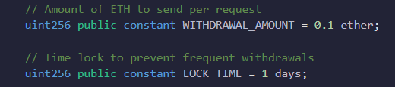
public constant → Makes this value readable by anyone (public) and unchangeable (constant).
Purpose: Sets a fixed amount of ETH (0.1 ether) that can be withdrawn per request and enforces a cooldown period (1 days) between withdrawals (to prevent abuse).
Why Use These Constants?
Security: LOCK_TIME prevents users from draining the contract by spamming withdrawals.
Fairness: WITHDRAWAL_AMOUNT prevents users from draining the contract by spamming withdrawals.
Gas Efficiency: constant values are embedded in the contract bytecode (no storage needed), saving gas.

Slide 7

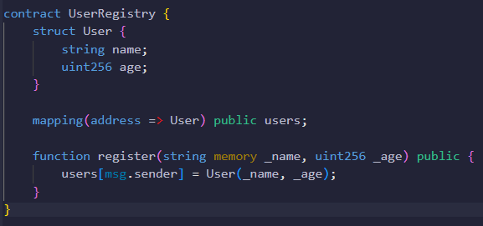
address | lastWithdrawalTime
0x1234ABC | 2025-03-12
0xABCD000 | 2020-12-13
0x7788990 | 2015-12-09
0x654321F | 2024-07-11
Creates a key-value store where:
Key: An Ethereum address (address)
Value: A timestamp (uint) representing the last withdrawal time
Purpose: Sets a fixed amount of ETH (0.1 ether) that can be withdrawn per request and enforces a cooldown period (1 days) between withdrawals (to prevent abuse).
Key: Can be almost any built-in type (address, uint, byte32, etc.), but not complex types like struct or anther mapping.
Value: Can be any type, including struct, array, or even another mapping.
The mapping keyword is used to declare a key-value data structure in Solidity.
lastWithdrawalTime[0x1234ABC]=2025-03-12
address | name | age
0x1234ABC | John | 26
0xABCD000 | Kim | 30
0x7788990 | MacArthur | 41
0x654321F | Lee | 28

Slide 8

"User 0x1234abcd withdrew 20 ETH“ in the event “Withdrawal”.
This line declares an event in Solidity that will be emitted (logged) whenever a withdrawal occurs in the smart contract.
What It Does
Creates a log entry on the blockchain whenever the withdrawal event is emitted.
Records which user (address) withdrew how much (uint256 amount).
The indexed keyword makes the user address filterable in blockchain explorers.
event keyword declares this as an event that can be emitted later.
The name of the event (can be anything descriptive) is withdrawal.
The withdrawing user's address is address indexed user. indexed allows efficient filtering of logs by this parameter.

Slide 9
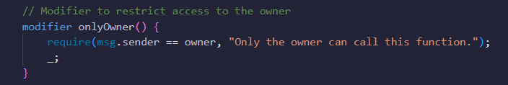
A modifier is a special type of function that you use to modify the behavior of other functions.
Modifiers allow you to add extra conditions or functionality to a function without having to rewrite the entire function.
To define a modifier, you use the modifier keyword followed by the name of the modifier and any parameters it may have.
In this example, the onlyOwner modifier has no parameters and includes a require statement that checks that the message sender is the contract owner.
If the message sender is the contract owner, the function will be executed. If the message sender is not the contract owner, the function will not execute.
The _; symbol is a special symbol that is used in Solidity modifiers to indicate the end of the modifier and the beginning of the function that the modifier is modifying.
The body of a modifier is made up of one or more statements that are used to modify the behavior of the function, and the _; symbol.

Slide 10
msg is a reserved global variable
Purpose: Provides metadata about the current call/transaction.
Availability: Automatically accessible in all functions (no need to declare).
Immutability: Values are read-only and set by the Ethereum Virtual Machine (EVM).
Property | Type | Description
msg.sender | address | Immediate caller of the function (EOA or contract). Who called the function (sender)
msg.value | uint256 | Amount of ETH (in wei) sent with the call. Only valid in payable functions. much ETH was sent (value)
msg.data | bytes calldata | Complete calldata (function selector + arguments) of the current call. The raw call data (data)

Slide 11

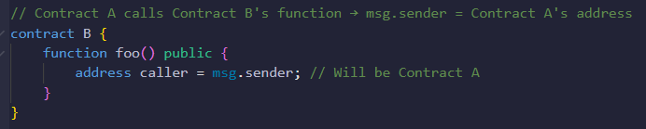
This line enforces that only the contract's owner can execute a function, by checking if the address calling the function (msg.sender) matches the owner's address (owner) and reverting with a specified error message if it doesn't.
msg.sender is a globally available variable that holds the address of the account or contract that initiated the current transaction or call.
For External Transactions: If a user (e.g., Alice) calls a contract function directly from their wallet (EOA, Externally Owned Account), msg.sender is Alice address.
For Contract-to-Contract Calls: If Contract A calls Contract B, msg.sender in Contract B is Contract A’s address (not the original user’s address).

Slide 12
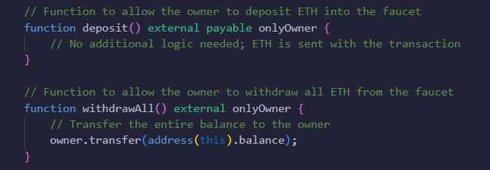
If msg.sender==owner (via onlyOwner), the function deposit() accepts ETH sent with the transaction (thanks to payable).
Otherwise, the function deposit() reverts with “Only the owner can call this function.”
If msg.sender==owner (via onlyOwner), the function withdrawAll() transfers the contract’s entire ETH balance to owner.
Otherwise, the function withdrawAll() reverts with “Only the owner can call this function.”

Slide 13
Feature | require | assert | revert
Purpose | Validate inputs/external conditions | Check internal invariants (bugs) | Custom error handling
Gas Refund | Yes (Refund unused gas) | No | Yes
Error Message | Optional | Not allowed | Required (via revert(“msg”))

Slide 14
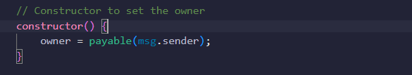
Constructor Definition
The constructor is a special function that runs exactly once when the contract is deployed.
It's where you initialize critical contract states.
Setting the Owner
msg.sender refers to the Ethereum address that deployed the contract.
This line assigns the deployer's address to the owner state variable.
The payable keyword makes the owner address capable of receiving ETH.
Example Flow
Alice deploys the contract
Constructor executes:
msg.sender = Alice’s address
owner variable now permanently stores Alice's address.
Only Alice can call owner-restricted functions.

Slide 15

What external Means:
Visibility: An external function can only be called from outside the contract (e.g., by another contract or via a transaction).
Cannot be called internally: Attempting to call an external function from within the same contract (without this.) will cause a compilation error.
Visibility | Callable Externally? | Callable Internally? | Gas Cost (External Call)
external | Yes | No (via this.) | Cheapest
public | Yes | Yes | Slightly higher
internal | No | Yes | N/A
private | No | Yes (same contract only) | N/A

Slide 16
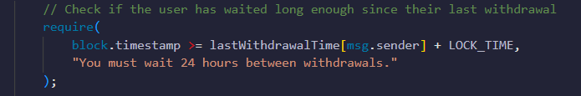
What block Means:
block is a reserved global variable in Solidity (not a keyword).
It provides information about the current blockchain block being mined.
Since it is hardcoded into Solidity, you cannot declare variables named block.
Property | Type | Description
block.timestamp | uint256 | Unix timestamp (seconds since Jan 1, 1970) of the current block.
block.number | uint256 | Current block number (height of the chain).
block.chainid | uint256 | ID of the current blockchain (e.g. 1 for Ethereum Mainnet).
block.coinbase | uint256 | Address of the miner/validator who mined the block (rarely used).
block.gaslimit | uint256 | Maximum gas allowed in the current block.

Slide 17
This Solidity code snippet enforces a time-based cooldown between withdrawals to prevent users from withdrawing funds too frequently.
Checks if the caller (msg.sender) has waited long enough since their last withdrawal.
Reverts the transaction if the condition fails, showing the error message.

Slide 18
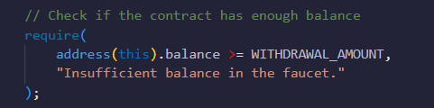
This snippet ensures the contract's balance is greater than or equal to WITHDRAWAL_AMOUNT.
The this refers to the current contract instance. It's a special keyword that allows the contract to reference its own address or call its own functions in an external context.
The this accesses the contract's own address or functions as if they were called externally.
address(this) returns the current contract's address as an address type.
.balance is a property of address that retrieves the ETH balance (in wei) stored at that address.

Slide 19

This line of Solidity code is responsible for sending ETH from the smart contract to the caller's address (msg.sender).
msg.sender: The address of the person/contract calling the function.
Example: 0x123…abc (Alice’s address)
payable(msg.sender) converts msg.sender from a plain address to a payable address.
Why? Regular addresses cannot receive ETH; payable enables transfers.
transfer(WITHDRAWAL_AMOUNT)
Sends WITHDRAWAL_AMOUNT (e.g., 0.1 ether) from the contract's balance to msg.sender.
Gas Limit: Caps gas at 2300, preventing reentrancy attacks (but may fail for complex fallbacks).
Reverts on Failure: If the recipient is a contract without a receive() or fallback() function, or if the contract lacks sufficient ETH.
Real-World Analogy (like a vending machine)
You (msg.sender) request a product (WITHDRAWAL_AMOUNT).
The machine (contract) checks its stock (address(this).balance).
If valid, it dispenses the product (ETH) to you.

Slide 20

This line is used to log a transaction event on the blockchain, specifically recording that a withdrawal has occurred.
When emit Withdrawal(msg.sender, WITHDRAWAL_AMOUNT); executes:
The event data (msg.sender, WITHDRAWAL_AMOUNT) is recorded in the transaction log.
Off-chain applications (like wallets or block explorers) can detect and display this event.
The withdrawal event must be defined earlier in the contract indexed parameters for filtering).

Slide 21
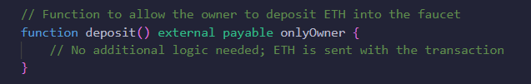
When the owner calls this function:
They must include ETH in the transaction (e.g., by setting a value in MetaMask)
The contract:
Verifies the caller is the owner (through onlyOwner)
Automatically stores the sent ETH in the contract's balance
Doesn't need additional logic because the ETH handling is built into the payable feature
This seemingly "empty“ deposit() function works without custom logic:
When you mark a function as payable, Solidity automatically credits any ETH sent with the transaction to the contract's balance.
When someone calls this function and attaches ETH (e.g., via MetaMask or another contract), the ETH is immediately added to address(this).balance.

Slide 22
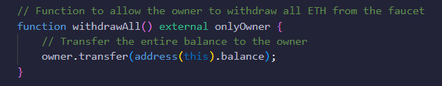
When called by owner:
Checks msg.sender == owner (via onlyOwner)
Reads contract's full ETH balance
Transfers entire balance to owner's address
owner.transfer transfers ETH from the contract to the owner address.

Slide 23
Faucet
Contract Structure
1. State Variables
owner: Stores the address of the contract creator (payable to receive funds)
WITHDRAWAL_AMOUNT: Fixed amount (0.1 ETH) given per withdrawal
LOCK_TIME: 24-hour cooldown period between withdrawals
lastWithdrawalTime: Tracks when each address last withdrew funds
2. Modifier
modifier onlyOwner() {
require(msg.sender == owner, "Only the owner can call this function.");
_;
}
Restricts function access to only the contract owner.
address payable public owner;
unit256 public constant WITHDRAWAL_AMOUNT = 0.1 ether;
uint256 public constant LOCK_TIME = 1 days;
mapping(address => uint256) public lastWithdrawalTime;
modifier onlyOwner() {
require(msg.sender == owner, "Only the owner can call this function.");
_;
}

Slide 24
Faucet
Key Functions
1. Constructor Function
constructor() {
owner = payable(msg.sender);
}
Sets the contract deployer as the owner during initialization.
In Solidity, a constructor is a special function that is automatically executed only once when a smart contract is deployed.
It is used to initialize the contract's state variables, set up initial conditions, or perform any one-time setup required for the contract.
Key features of a constructor in Solidity:
Runs Only Once: Executed automatically when the contract is deployed.
No Name: Defined using the constructor keyword (since Solidity 0.4.22).
Optional: A contract doesn't need a constructor if no initialization is required.
Can Take Arguments: Allows setting initial values during deployment.
Public or Internal Visibility: Can be public (default) or internal (if the contract is abstract).
No Return Value: Cannot return any data.
constructor() {
owner = payable(msg.sender);
}

Slide 25
Faucet
Key Functions
2. Withdraw Function (Main Faucet Logic)
Checks if user has waited 24 hours since last withdrawal
Verifies contract has sufficient funds
Updates withdrawal timestamp
Sends 0.1 ETH to requester
Emits withdrawal event
function withdraw() external {
require(
block.timestamp >= lastWithdrawalTime[msg.sender] + LOCK_TIME,
"You must wait 24 hours between withdrawals."
);
require(
address(this).balance >= WITHDRAWAL_AMOUNT,
"Insufficient balance in the faucet."
);
lastWithdrawalTime[msg.sender] = block.timestamp;
payable(msg.sender).transfer(WITHDRAWAL_AMOUNT);
emit Withdrawal(msg.sender, WITHDRAWAL_AMOUNT);
}

Slide 26
Faucet
Key Functions
3. Owner Function
deposit(): Allows owner to add funds to the faucet
withdrawAll(): Lets owner retrieve all contract funds
4. Receive Function
Accepts ETH sent directly to the contract address.
The receive() function is a special function introduced in Solidity 0.6.0 to handle plain Ether transfers (when someone sends Ether to the contract without any transaction data).
It is designed to replace part of the old fallback() function’s behavior.
function deposit() external payable onlyOwner {}
function withdrawAll() external onlyOwner {
owner.transfer(address(this).balance);
}
receive() external payable {}

Slide 27
Faucet
Key Functions
4. Receive Function
Accepts ETH sent directly to the contract address.
The receive() function is a special function introduced in Solidity 0.6.0 to handle plain Ether transfers (when someone sends Ether to the contract without any transaction data).
It is designed to replace part of the old fallback() function’s behavior.
Key Features:
Trigger Condition:
Executed only when Ether is sent to the contract with empty msg.data (e.g., via send() or transfer()).
If receive() doesn’t exist, the fallback() function is called.
Must be payable:
If not marked payable, the contract will reject plain Ether transfers.
No Arguments or Return Values:
Cannot take inputs or return data (but can emit events or modify state).
receive() external payable {}

Slide 28
Faucet
Security Features
Access Control: Only owner can deposit/withdraw all funds
Rate Limiting: 24-hour cooldown prevents abuse
Balance Checks: Ensures faucet has funds before sending
Immutable Parameters: Withdrawal amount and lock time are constants
Typical Usage Flow
Owner deploys contract
Owner funds the contract (via deposit() or direct transfer)
Users call withdraw() to get 0.1 ETH (once per day)
Owner can add more funds or withdraw remaining balance

Slide 29
Faucet
Home Assignment
Try to understand the Faucet.sol code.
Check the change of values of msg.sender and msg.value.
Your team will present what your team members understood next time.

